Slide 1
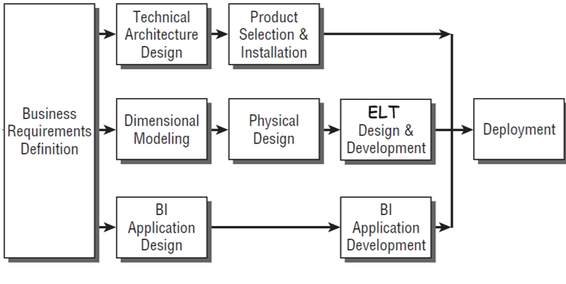

DW/BI Lifecycle

Slide 2
Business Requirements Definition

Slide 3

Understanding Business Requirements
The number of trips within months:
Are bikes used more in February or June, or September maybe?
The average trip duration/distance within a specific period of time
Are trips longer in February compared to June?
Bikes Usage
The number of trips by weather condition:
Are bikes used more when the weather is sunny or rainy?
Weather condition

Slide 4
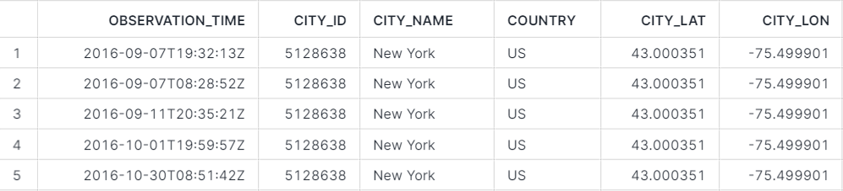
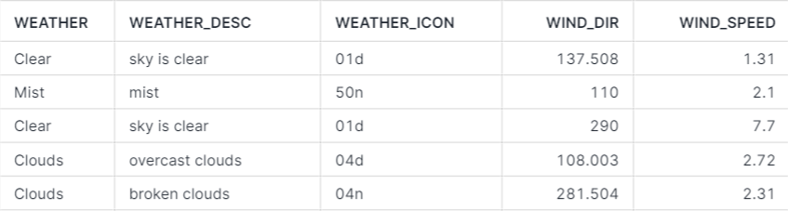
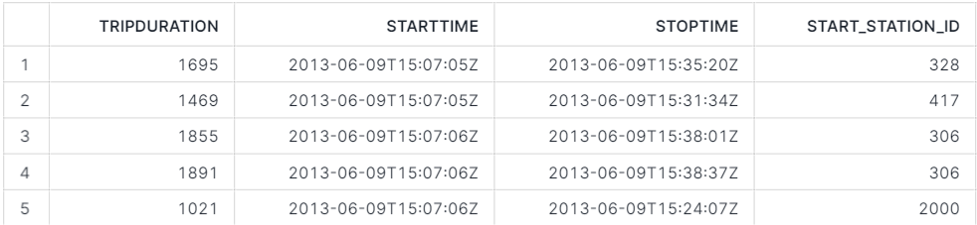
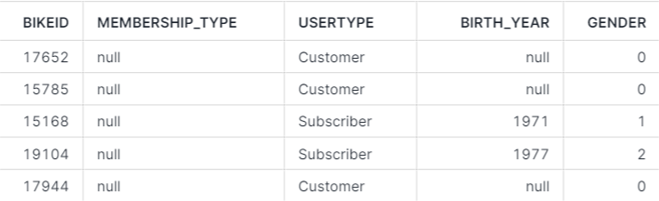
Understanding Data Realities
Data Profiling
Weather data
S3 bucket: s3://snowflake-workshop-lab/weather-nyc
Bike data
S3 bucket: s3://snowflake-workshop-lab/citibike-trips

Slide 5
Technical Architecture Design

Slide 6

Technical Architecture Design
External
Data Sources
Raw Data
Prepared Data
Report
Ingest
Process
Analyze

Slide 7
Product Selection & Installation

Slide 8




Product Selection & Installation
External
Data Sources
Raw Data
Prepared Data
Report
EL
T

Slide 9
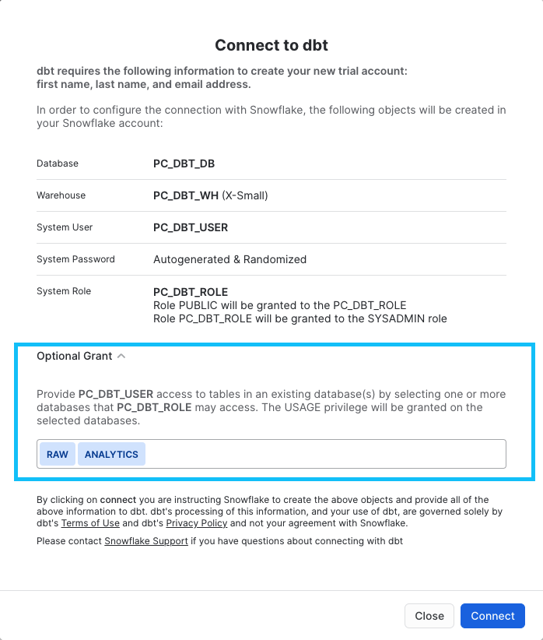
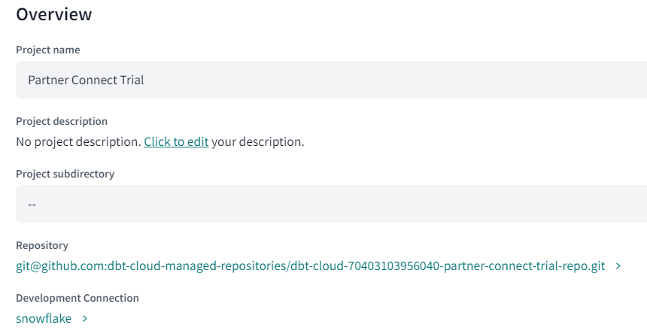
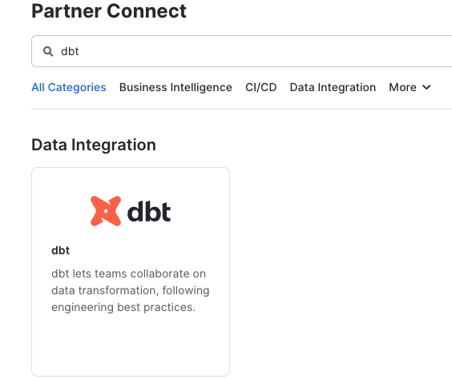
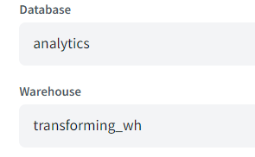
Dbt Cloud – Connect to Snowflake via Partner Connect
Step 1
Step 2
Step 3

Slide 10
Dimensional Modeling

Slide 11
Dimensional Modeling
Dimension
Weather
Fact
Trips

Slide 12
Physical Design

Slide 13


Physical Design – Creating the Databases, Schemas, Tables
Creating the Warehouse
Create the Databases
Create the Schemas
Create the Tables

Slide 14
ELT Design & Development

Slide 15


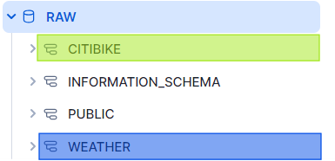
ELT Design & Development – Ingesting the Data
Create Stages
Create External
EL
Ingest Data into Corresponding Tables

Slide 16
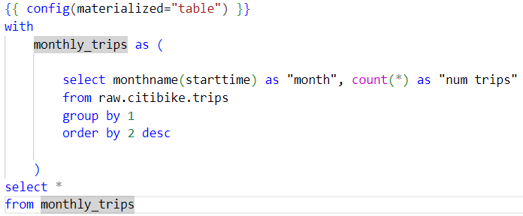
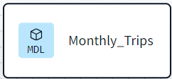
ELT Design & Development – Building the Models
The number of trips within months
Trips
Monthly_Trips
T

Slide 17
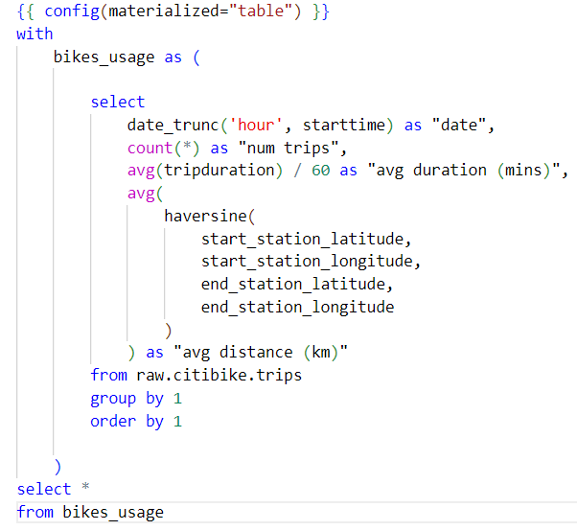
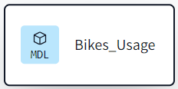
ELT Design & Development – Building the Models
The average trip duration/distance within a specific period of time
Trips
Bikes_Usage
T

Slide 18
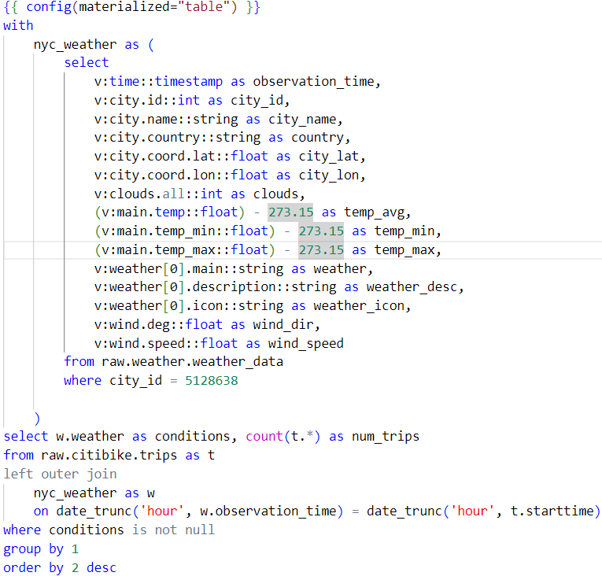
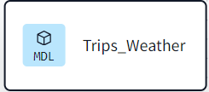
ELT Design & Development – Building the Models
The number of trips by weather condition
Trips
Bikes_Usage
T
Weather

Slide 19
BI Application Design & Development

Slide 20
BI Application Design & Development
The number of trips within months.
The average trip duration/distance within a specific period of time
The number of trips by weather condition:

Slide 21
Deployment

Slide 22
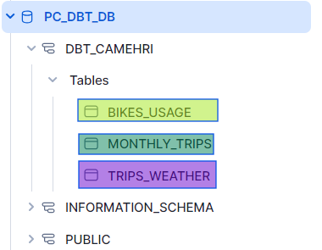
Deployment
External
Data Sources
Raw Data
Prepared Data
EL
T

Slide 23
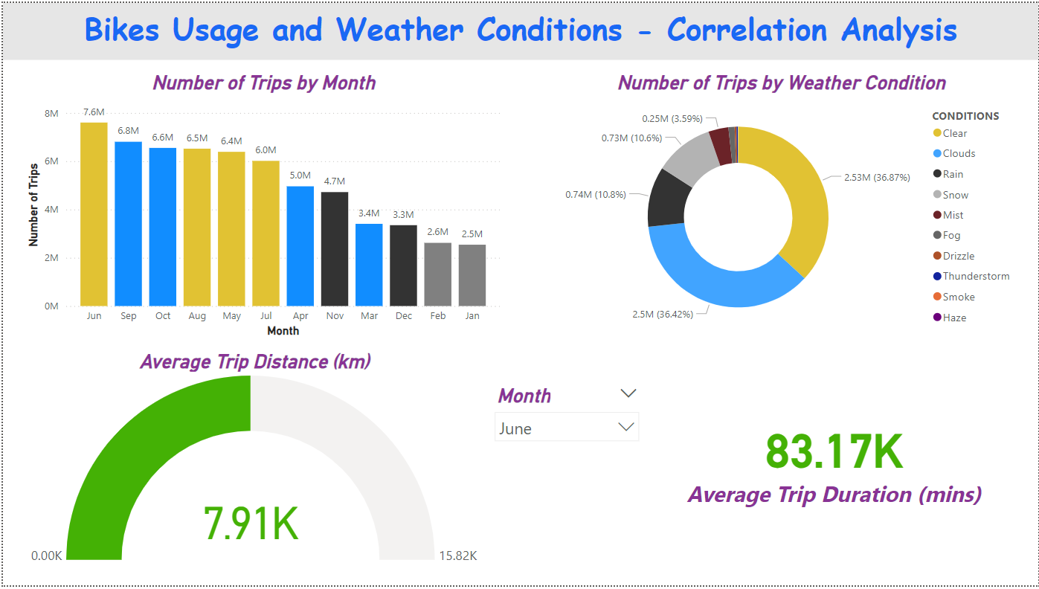
Deployment

